Slide 1
-+<>[].,
Aur Saraf

Slide 2
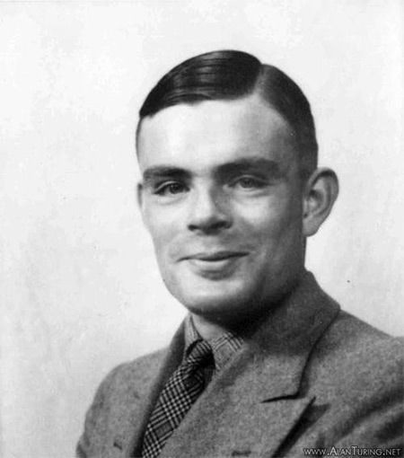

Slide 3
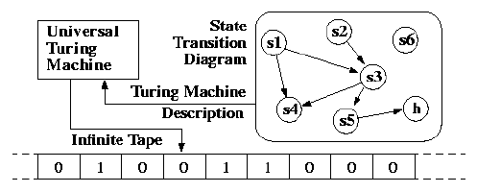

Slide 4
min

Slide 5
buffer of bytes, pointer
-+
increase/decrease
<>
forward/back
[]
while
.,
out/in

Slide 6
current <- 15
>+++++[-<+++>]

Slide 7
hello, world!
++++++++++[>+++++++>++++++++++>+++>+<<<<-]>++.>+.+++++++..+++.>++.<<+++++++++++++++.>.+++.------.--------.>+.>.

Slide 8
Universal Turing Machine
+++>++>>>+[>>,[>+++++<[[->]<<]<[>]>]>-[<<+++++>>-[<<---->>-[->]<]]<[<-<[<]+<+[>]<<+>->>>]<]<[<]>[-[>++++++<-]>[<+>-]+<<<+++>+>[-[<<+>->-[<<[-]>>-[<<++>+>-[<<-->->>+++<-[<<+>+>>--<-[<<->->-[<<++++>+>>+<-[>-<-[<<->->-[<<->>-[<<+++>>>-<-[<<---->>>++<-[<<++>>>+<-[>[-]<-[<<->>>+++<-[<<->>>--<-[<<++++>+>>+<-[<<[-]>->>++<-[<<+++++>+>>--<-[<->>++<[<<->>-]]]]]]]]]]]]]]]]]]]]]]<[->>[<<+>>-]<<<[>>>+<<<-]<[>>>+<<<-]]>>]>[-[---[-<]]>]>[+++[<+++++>--]>]+<++[[>+++++<-]<]>>[-.>]
© Daniel B Cristofani, http://www.hevanet.com/cristofd/brainfuck/utm.b

Slide 9
???
+++++++++[<+++++>-],[[-<--.++<+>>]<+.-<[->.<]>>,]

Slide 10
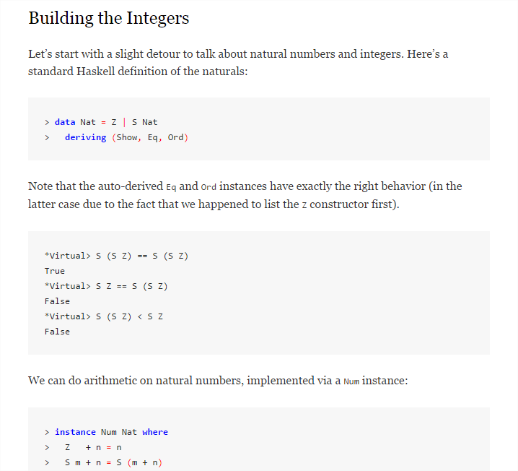
literate programming

Slide 11
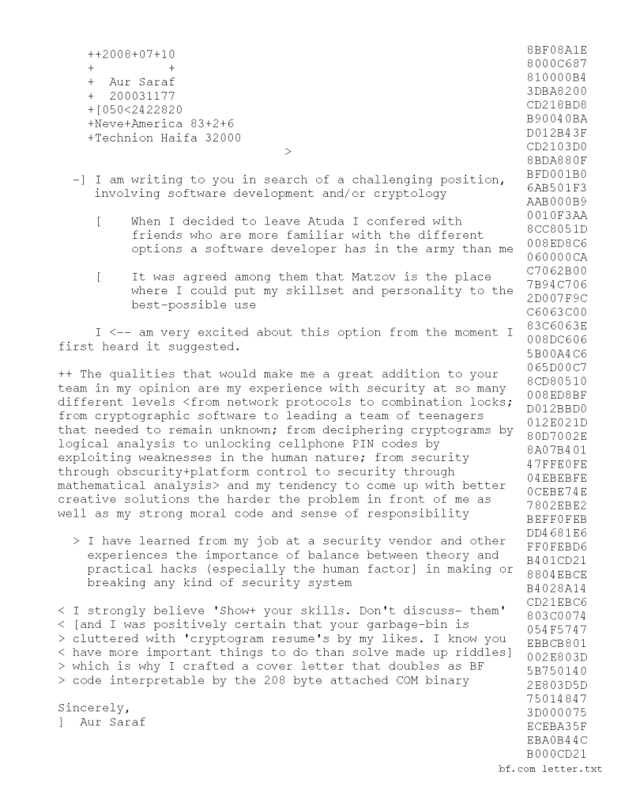
literate brainfuck

Slide 14
lets write a vm

Slide 15
questions?
hope you had fun.
Aur Saraf

